Slide 1
INTERACTION DESIGN BASICS
INTRODUCTION

Slide 2
Introduction to Interaction Design
Interaction design (IxD) is the practice of designing digital products, systems, and services with a focus on user behavior and experience.

Slide 3
Goals:
Create intuitive, efficient, and enjoyable interactions.
Facilitate meaningful communication between users and systems.
Enhance usability and accessibility.

Slide 4
Interaction design is about how the artifact produced is going to affect the way people work: the design of interventions.
What to consider
Design: achieving goals within constraints.
Goals: the purpose of the design we are intending to produce
Constrain: the limitations on the design process by external factors
Trade-off: choosing which goals or constraints can be relaxed so that others can be met.

Slide 5
Why is Interactive Design Important?
Interaction design is crucial for ensuring user satisfaction, engagement, and task completion in digital products.
The golden rule of design
Understand your material: computers (limitations, capacities, tools, platforms) and people (psychological, social aspects, human error)

Slide 6
To err is human
It is the nature of humans to make mistakes and systems should be designed to reduce the likelihood of those mistakes and to minimize the consequences when mistakes happen.
The central message: the user
During design, always concentrate on the user.

Slide 7
Principles of Interaction Design
Usability: Products should be easy to learn, efficient to use, and error-tolerant.
Affordance: Design elements should suggest their functionality or use, guiding users in their interactions.
Feedback: Systems should provide clear and timely feedback to users for every action they perform.
Consistency: Maintain consistency in design elements, behavior, and terminology throughout the system.

Slide 8
Learnability: Users should be able to quickly understand how to use the system and improve their proficiency over time.
Visibility: Make important functions and features visible to users, reducing the need for extensive exploration.
Hierarchy: Organize content and features in a logical hierarchy to help users navigate and find what they need.

Slide 9
Process of Interaction Design
Research: Understand user needs, goals, and behaviors through methods such as user interviews, surveys, and usability testing.
This will help one to understand the requirements of the solution
Requirements: Through observations and interviews, the features of the system to be designed are mapped.

Slide 10
Analysis: Analyze research findings to identify patterns, pain points, and opportunities for improvement. Through various methods, order the gathered requirements to bring out key issues.
Design: Various design guidelines help you to move from what you want to how to do it. At this level generate ideas and concepts for the product's interaction model, interface layout, and visual design.

Slide 11
Iteration and prototyping: Create interactive prototypes to test and validate design concepts with users. Then try out early versions of the system with real users. This will help iron out design issues early in the project.
Evaluation: Conduct usability testing and gather feedback from users to iterate and refine the design.
Implementation: Develop the final product based on the approved design, considering technical feasibility and constraints like writing code, documentation and make hardware.

Slide 12
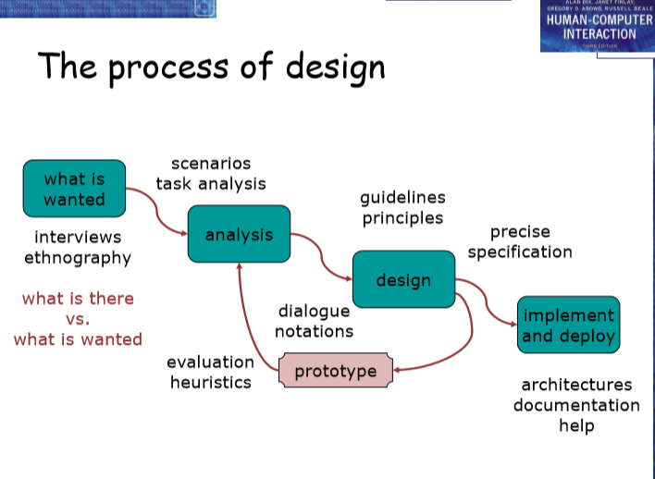

Slide 13
User focus
Once more: gather as much information as possible about the future users of the system. Terminology:
Stakeholders: people affected directly or indirectly by a system
Participatory design: bringing a potential user fully into the design process

Slide 14
Know your user
who are they?
probably not like you!
talk to them
watch them
use your imagination

Slide 15
Persona:
Is a rich picture of an imaginary person who represents your core user group
What's the description of an ‘example’ user
not necessarily a real person
Can be used as surrogate user
what would Betty think
Details matter
makes her ‘real’

Slide 16
Betty is 37 years old, She has been Warehouse Manager for five years and worked for Simpkins Brothers Engineering for twelve years. She didn’t go to university, but has studied in her evenings for a business diploma. She has two children aged 15 and 7 and does not like to work late. She did part of an introductory in-house computer course some years ago, but it was interrupted when she was promoted and could no longer afford to take the time. Her vision is perfect, but her right-hand movement is slightly restricted following an industrial accident 3 years ago. She is enthusiastic about her work and is happy to delegate responsibility and take suggestions from her staff. However, she does feel threatened by the introduction of yet another new computer system (the third in her time at SBE).

Slide 17
Carry out cultural probes
Direct observation
sometimes hard
in the home
psychiatric patients, …
Probe packs
items to prompt responses
e.g. glass to listen at wall, camera, postcard
given to people to open in their own environment they record what is meaningful to them
used to …
inform interviews, prompt ideas, culture designers

Slide 18
Scenarios
Scenarios are stories for design: rich stories of interaction sometimes illustrated with storyboards.
We use scenarios for design
communicate with others
validate other models
understand dynamics
Linearity
time is linear - our lives are linear
but don’t show alternatives

Slide 19
Scenarios Cont.
what will users want to do?
Step-by-step walkthrough
what can they see (sketches, screen shots)
what do they do (keyboard, mouse etc.)
what are they thinking?
Use and reuse throughout design

Slide 20
Example
Scenario – movie player
Brian would like to see the new film “Moments of Significance” and wants to invite Alison, but he knows she doesn’t like “arty” films. He decides to take a look at it to see if she would like it and so connects to one of the movie sharing networks. He uses his work machine as it has a higher bandwidth connection, but feels a bit guilty. He knows he will be getting an illegal copy of the film, but decides it is OK as he is intending to go to the cinema to watch it. After it downloads to his machine he takes out his new personal movie player. He presses the ‘menu’ button and on the small LCD screen he scrolls using the arrow keys to ‘bluetooth connect’ and presses the select button. On his computer the movie download program now has an icon showing that it has recognised a compatible device and he drags the icon of the film over the icon for the player. On the player the LCD screen says “downloading now”, a percent done indicator and small whirling icon. …

Slide 21
Play Act
mock up device
pretend you are doing it
Explore The Depths
Explore interaction
what happens when
Explore cognition
what are the users thinking
Explore architecture
what is happening inside

Slide 22
Tools and Techniques
Wire framing and Prototyping Tools: Software like Sketch, Adobe XD, and Figma are commonly used for creating wireframes and interactive prototypes.
User Flows: Diagrams that illustrate the paths users take to complete tasks or achieve goals within a system.

Slide 23
Storyboarding: Visual narratives that depict the sequence of interactions between users and the system.
Usability Testing: Observing users as they interact with prototypes or the final product to identify usability issues and gather feedback

Slide 24
Navigation design
Local structure (Single Screen)
Much of interaction involves goal-seeking behavior, because users do not know the system entirely. Therefore, the interface should always make clear:
where you are
what you can do

Slide 25
Where you are going/what will happen in terms of the interaction or state of the system.
Furthermore:
Icons are not self-explanatory: they should be explained!
The different meaning of the same command in different modes should be clear.

Slide 26
The system should give feedback about the effect of an action. In most information systems, it is as essential to know where you have been.
Global structure - hierarchical organization (Whole Site)
Overall structure of an application: the way the various screens, pages or physical device states link to one another. This can be done using hierarchy:
Humans tend to be better at using this structure, as long as the hierarchy does not go to deep.

Slide 27
Global structure - dialog
Dialog: the pattern of non-hierarchical interaction occurring when the user performs a certain action, e.g. deleting a .le.
Wider still
Style issues: we should conform to platform standards
Functionality issues: the program being created should conform to standard functions.
Navigation issues: Its prudent in design to support linkages between applications to make user movement easier

Slide 28
Screen design and layout
Tools for layout
Grouping and structure: if things logically belong together, then we should normally visually group them together.
Order of groups and items: the order on the screen should follow the natural order for the user.

Slide 29
Decoration: decorations can be used to emphasize grouping.
Alignment: the proper use of alignment can help the user to find information in lists and columns quickly.
White space: white space can be used to separate blocks, highlight structures etc.

Slide 30
Appropriate appearance
The way of presenting information on screen depends on the kind of information, the technologies available to present it and the purpose for which it is used.
We have an advantage when presenting information in an interactive system in that it is easy to allow the user to choose among several representations, thus making it possible to achieve different goals.

Slide 31
In an ideal design, the interface is both usable and aesthetically pleasing.
However, the looks of the interface should never come to the disadvantage of the usability. This is mostly the case with the excessive use of color and 3D.
Localization/internationalization: the process of making software suitable for different cultures and languages.

Slide 32
Iteration and prototyping
Formative evaluation: intended to improve designs.
Summative evaluation: verify whether the product is good enough.
In order for prototyping methods to work, you need to understand what is wrong and how to improve it, and you also need a good starting point.
If the design is very complex, it is sometimes wise to start with various alternatives and to drop them one by one during the design process.

Slide 33
Trends and Considerations (In Interactive Design)
Mobile-First Design: Prioritizing the design and optimization of user experiences for mobile devices.
Accessibility: Ensuring digital products are usable by people with disabilities, including considerations for screen readers, keyboard navigation, and color contrast.

Slide 34
Voice User Interfaces (VUI): Designing interactions that rely on voice commands and responses, such as virtual assistants.
Augmented Reality (AR) and Virtual Reality (VR): Exploring new interaction paradigms in immersive environments.

